Slide 1

TravelEase - Online Bus Booking System
Shree Vidyadhiraj Polytechnic, Kumta
Team Members:
B.S. Niranjan
Subrahmanya I Patgar
Rahul N Shanbhag
Vishwas Barker
Farhan Faras

Slide 2


Problem Statement
Traditional ticket booking involves long manual queues.
(9
iiiiii
fta
�1�i1
� 9
Difficulty in obtaining real-time availability information.
Administrative burden of managing bookings manually.
--
�

Slide 3


Project Objectives
,� �] Provide an easy-to-use online
� booking platform.
Enable real-time ticket availability v1• ew1• ng.
Facilitate instant booking confirmations and efficient admin management.

Slide 4
Technology Stack: MERN
Four Core Technologies: MongoDB, Express.js, React.js, and Node.js.
@) |  | ®
MongoDB NoSQL Database | - | Express.js Web Application Framework
@ |  | @
React.js JavaScript Library | - | Node.js JavaScript Runtime Environment
-

Slide 5


Frontend: React.js
Building interactive UI for destination exploration and profile management.
Em
@
000
DestinationExploration
c=:::>
¢==1
®
ProfileManagement
Personal Information
Filters
(
)CS)
) (
�
=
( )
( )
000
=
D
D
D
D
•
Efficient statemanagement for seamless navigation and data updates.
dynamic^{Component-based}responsiveand ^{architecture}niuser te^{for}far ces.

Slide 6


System Component: Backend Server
nve {Express}
Built using Node.js and
Express.js.
Responsible for core business logic and processing bookings.

Slide 7
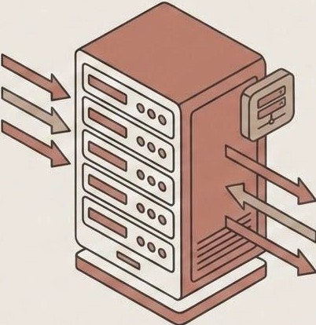
Backend: Express.js & Node.js
0 Express.js
Creating RESTful APls for authentication and payments.
e Node.js
Core logic handler for coordinating
frontend and database.

Slide 8




Database Implementation (MongoDB Snapshot)
Bus Information Collection (Buses)
Real-time Booking Collection (Bookings)
r
{
"_id": "bus_001", "registration_number": "KA-10-FL-5404", "operator": "KSRTC",
"type": "AC Sleeper", "capacity": 30
}
{
DATA FLOW
"_id": "booking_98765", "user_id": "user_123", "bus id": "bus 001", "status": • CONFIRMED",
"booking_time": "2024-05-10Tl4:30:00Z", "seat_numbe r": "A4"
}
Stores bus details, including registration, operator, and capacity.
Records real-time booking transactions with immediate status updates.
Utilizing MongoDB's flexible schema for scalable and efficient data management.

Slide 9


Software Products (Development)
VS Code
Primary source code editor and Git manager.
GitHub
Version control and team collaboration platform.

Slide 10


Software Products (Testing)
==
Google Chrome &
React Dev Tools
Browser debugging and UI inspection.
0
= Postman
API development, testing, and documentation.

Slide 11

Hardware Requirements
Essential physical and infrastructure resources for development and deployment.
Processor
Intel Core i3 or higher
Storage
At least 1 GB free disk space
Ram
4 GB Minimum (8 GB Recommended)

Slide 12
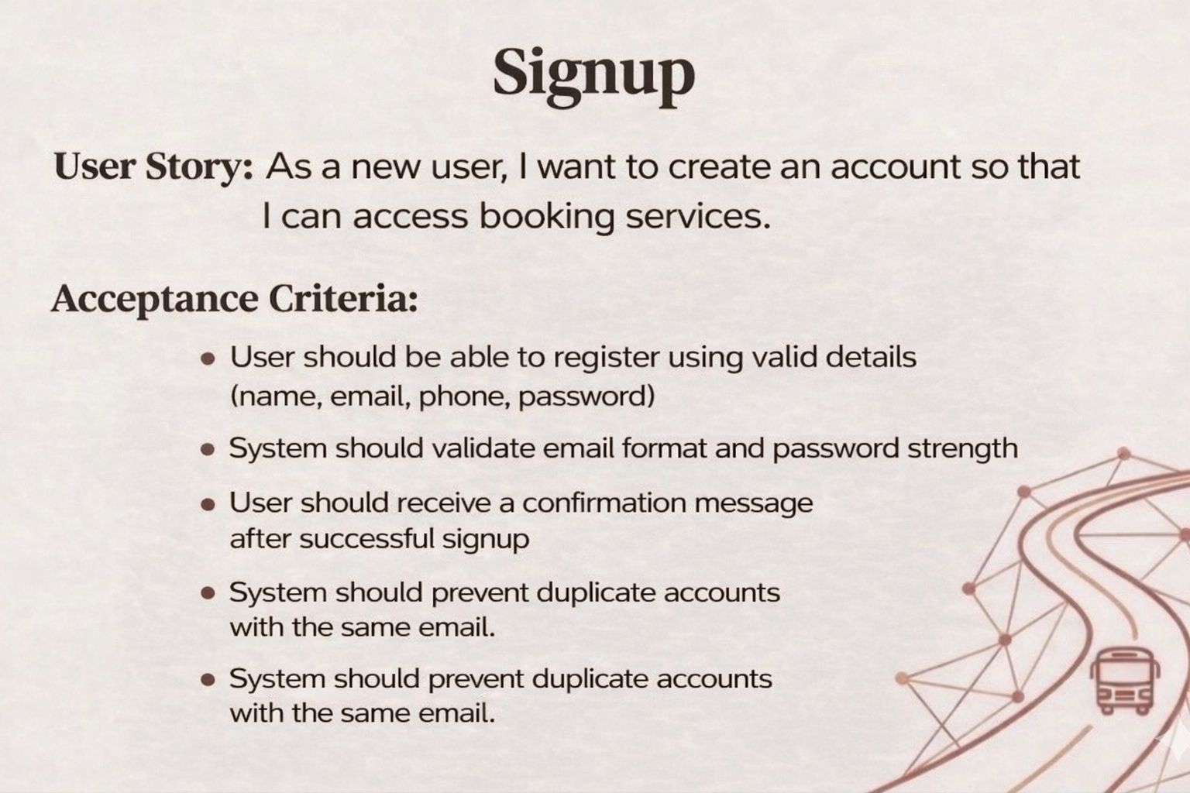
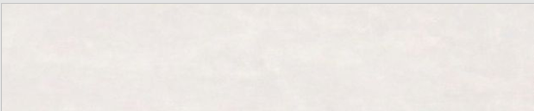

Slide 13

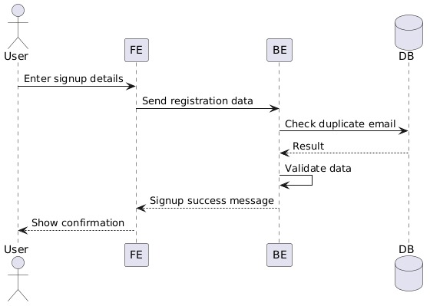

Slide 14

Test Case for Sign-Up
Test No | Test Name | Test data | Test description | Result
1 | Reg Page | Email: newuser@example.com, Password: pass123 | Valid registration details | Pass
2 | Reg Page | Email: existing@example.com, Password: pass123 | Duplicate email registration | Fail
3 | Reg Page | Email: '', Password: pass123 | Missing mandatory fields | Fail

Slide 15
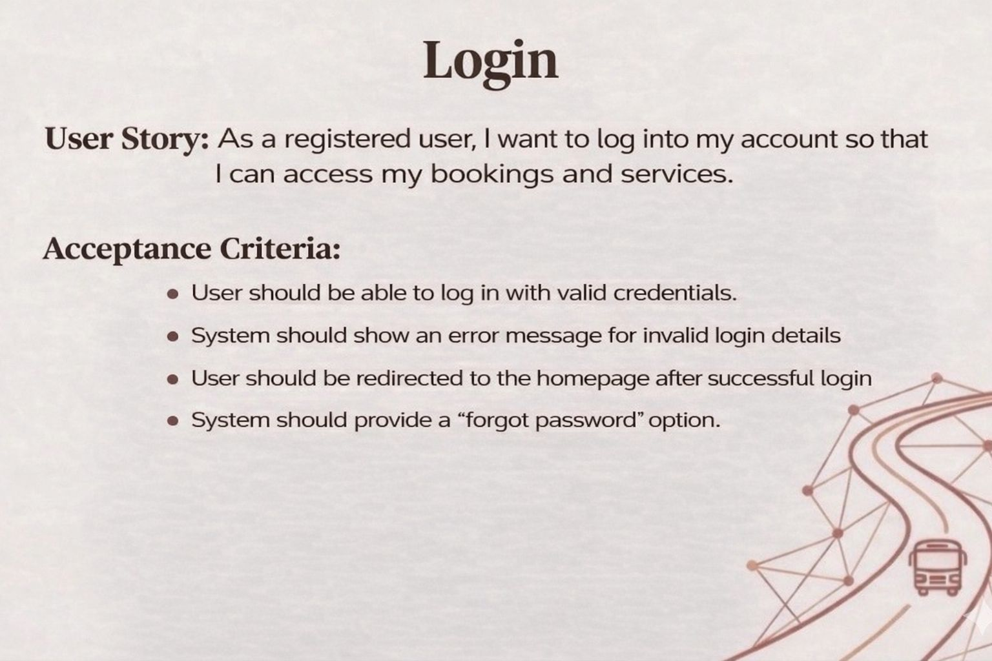

Slide 16
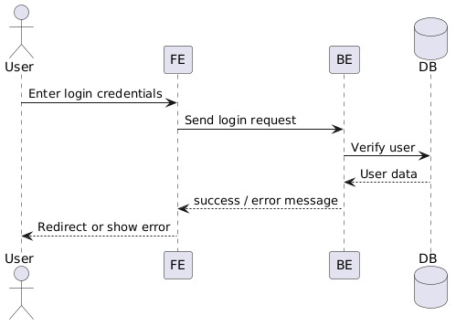

Slide 17
Test Case for Login
Test No | Test Name | Test Data | Test Description | Result
1 | Login Page | Username: user1, Password: correctpass | Valid login credentials | Pass
2 | Login Page | Username: user1, Password: wrongpass | Invalid login credentials | Fail
3 | Login Page | Username: '', Password: '' | Empty username and password fields | Fail

Slide 18
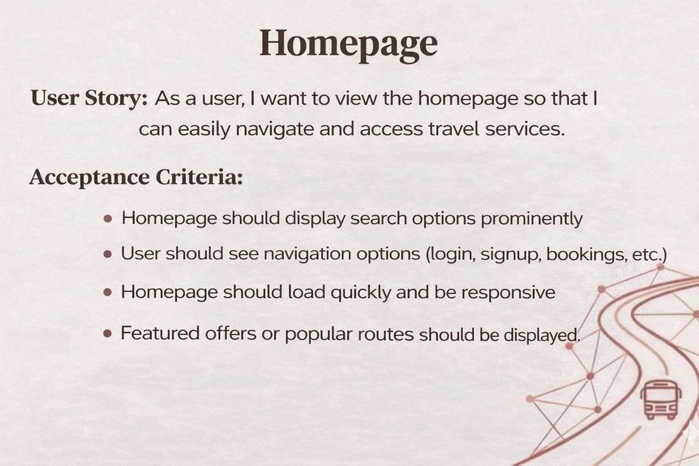

Slide 19
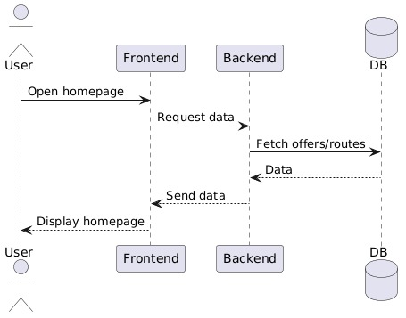

Slide 20
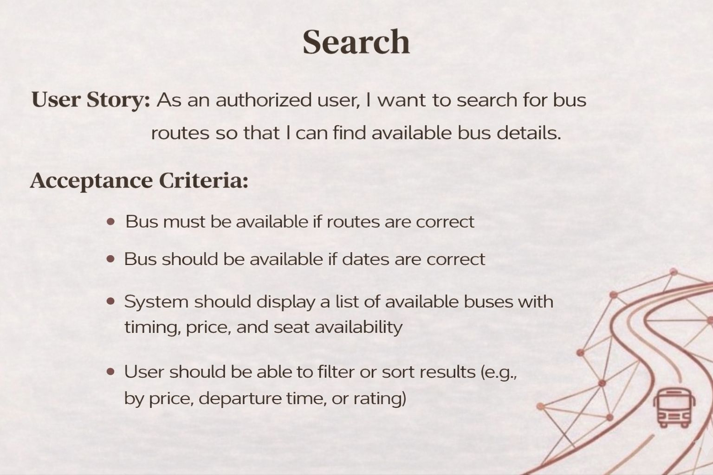

Slide 21
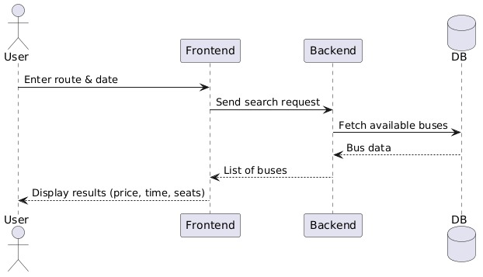

Slide 22
Test Case for Search
Test No | Test Name | Test Data | Test Description | Result
7 | Search Bar | From: CityA, To: CityB, Date: 2026-04-10 | Valid bus route search | Pass
8 | Search Bar | From: CityX, To: CityY, Date: 2026-04-10 | Invalid bus route search | Fail
9 | Search Bar | From: '', To: '', Date: '' | Empty search fields | Fail

Slide 23
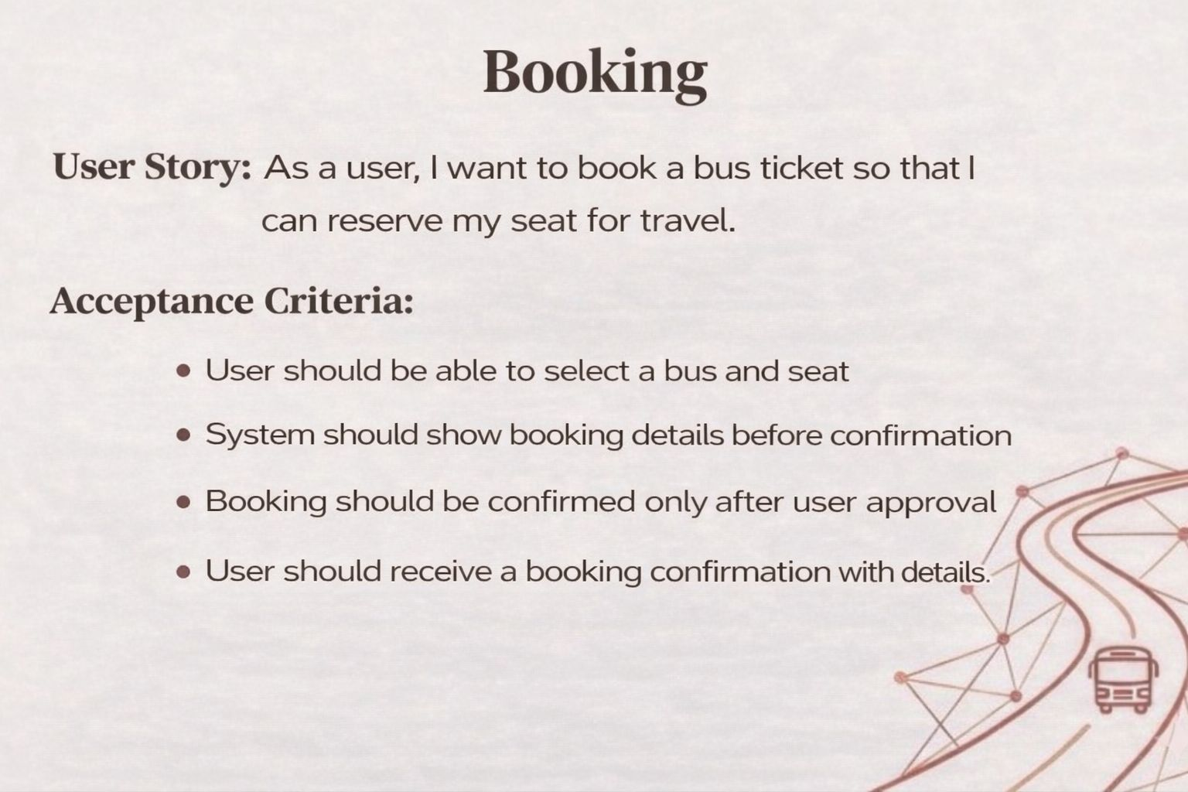

Slide 24
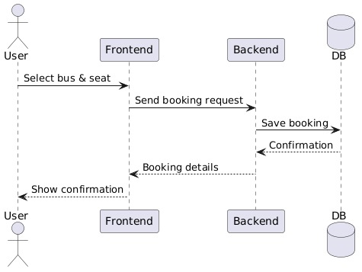

Slide 25
Test Case for Booking
Test No | Test Name | Test Data | Test Description | Result
1 | Booking | Bus ID: 123, Seat: A1, Name: John Doe | Valid booking | Pass
2 | Booking | Bus ID: 123, Seat: '', Name: John Doe | Booking without selecting seat | Fail
3 | Booking | Bus ID: 123, Seat: A1, Name: '' | Booking with invalid passenger details | Fail

Slide 26
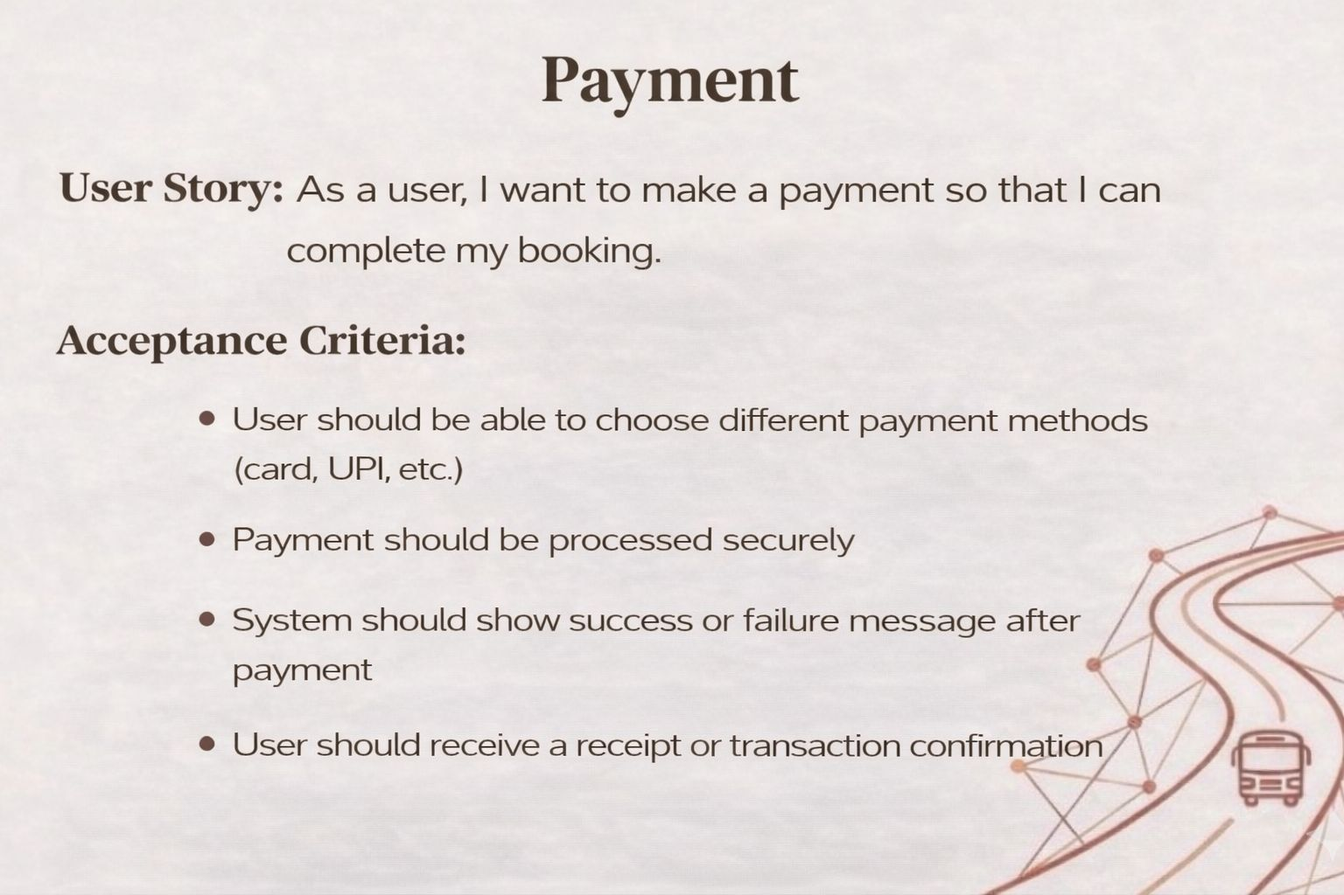

Slide 27
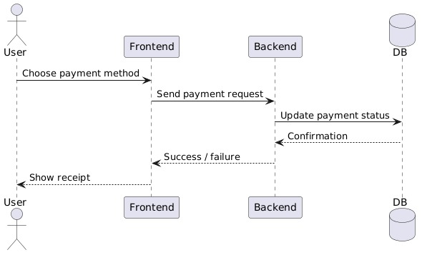

Slide 28
Test Case for Payment
Test No | Test Name | Test Data | Test Description | Result
1 | Payment | Card: 4111111111111111, Exp: 12/28, CVV: 123 | Successful payment | Pass
2 | Payment | Card: 4000000000000002, Exp: 12/28, CVV: 123 | Payment declined | Fail
3 | Payment | Card: 1234567890123456, Exp: 12/28, CVV: abc | Payment with invalid card details | Fail

Slide 29
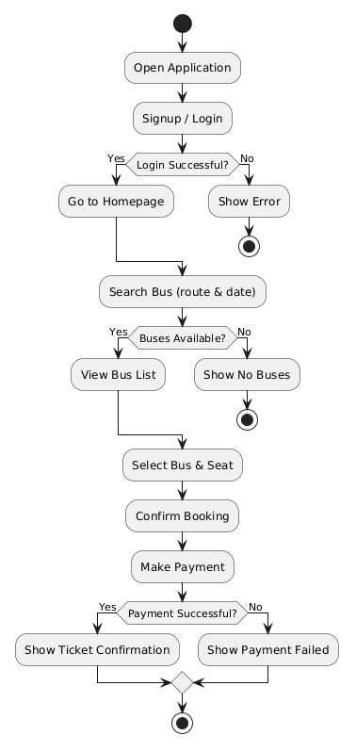
Activity Diagram for TravelEase Bus Booking Application

Slide 30





Compatibility & Cross-Browser Testing
Device Compatibility Testing
Cross-Browser Validation
.,
0 Testing on desktops, tablets, and smartphones.
0 Validation on Firefox and Microsoft Edge.

Slide 31


Security Testing Implementation
Secure Login &
Encryption
Secure login authentication and password encryption.
Role-Based Access Control
Role-based access control to prevent unauthorized admin access.

Slide 32

Database Implementation (MongoDB Snapshot)
Bus Information Collection (Buses)
Real-time Booking Collection (Bookings)
r
{
"_id": "bus_001", "registration_number": "KA-10-FL-5404", "operator": "KSRTC",
"type": "AC Sleeper", "capacity": 30
}
{
"_id": "booking_98765", "user_id": "user_123", "bus id": "bus 001", "status": • CONFIRMED",
"booking_time": "2024-05-10Tl4:30:00Z", "seat_numbe r": "A4"
�
Data Flow
}
Stores bus details, including registration, operator, and capacity.
Records real-time booking transactions with immediate status updates.
Utilizing MongoDB's flexible schema for scalable and efficient data management.

Slide 33



Inference & Conclusion
User Experience
Technical Implementation
TravelEase delivers a satisfying user experience with clear info and real-time updates.
The Agile-MERN combination successfully produced a functional, scalable system.

Slide 34
